Slide 1
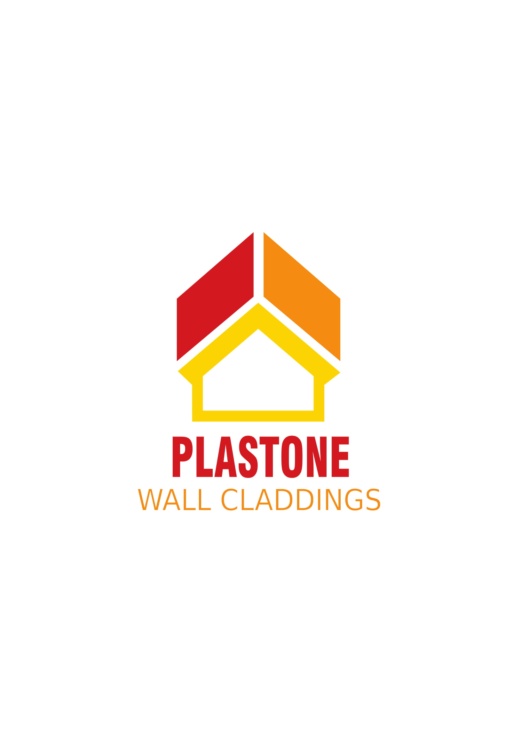

Slide 2

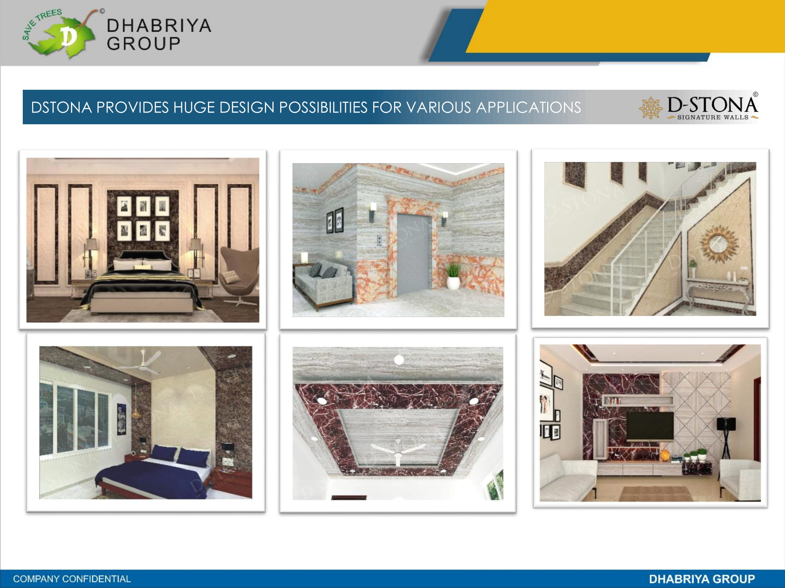
PROVIDES HUGE DESIGN POSSIBILITES FOR VARIOUS APPLICATIONS

Slide 3
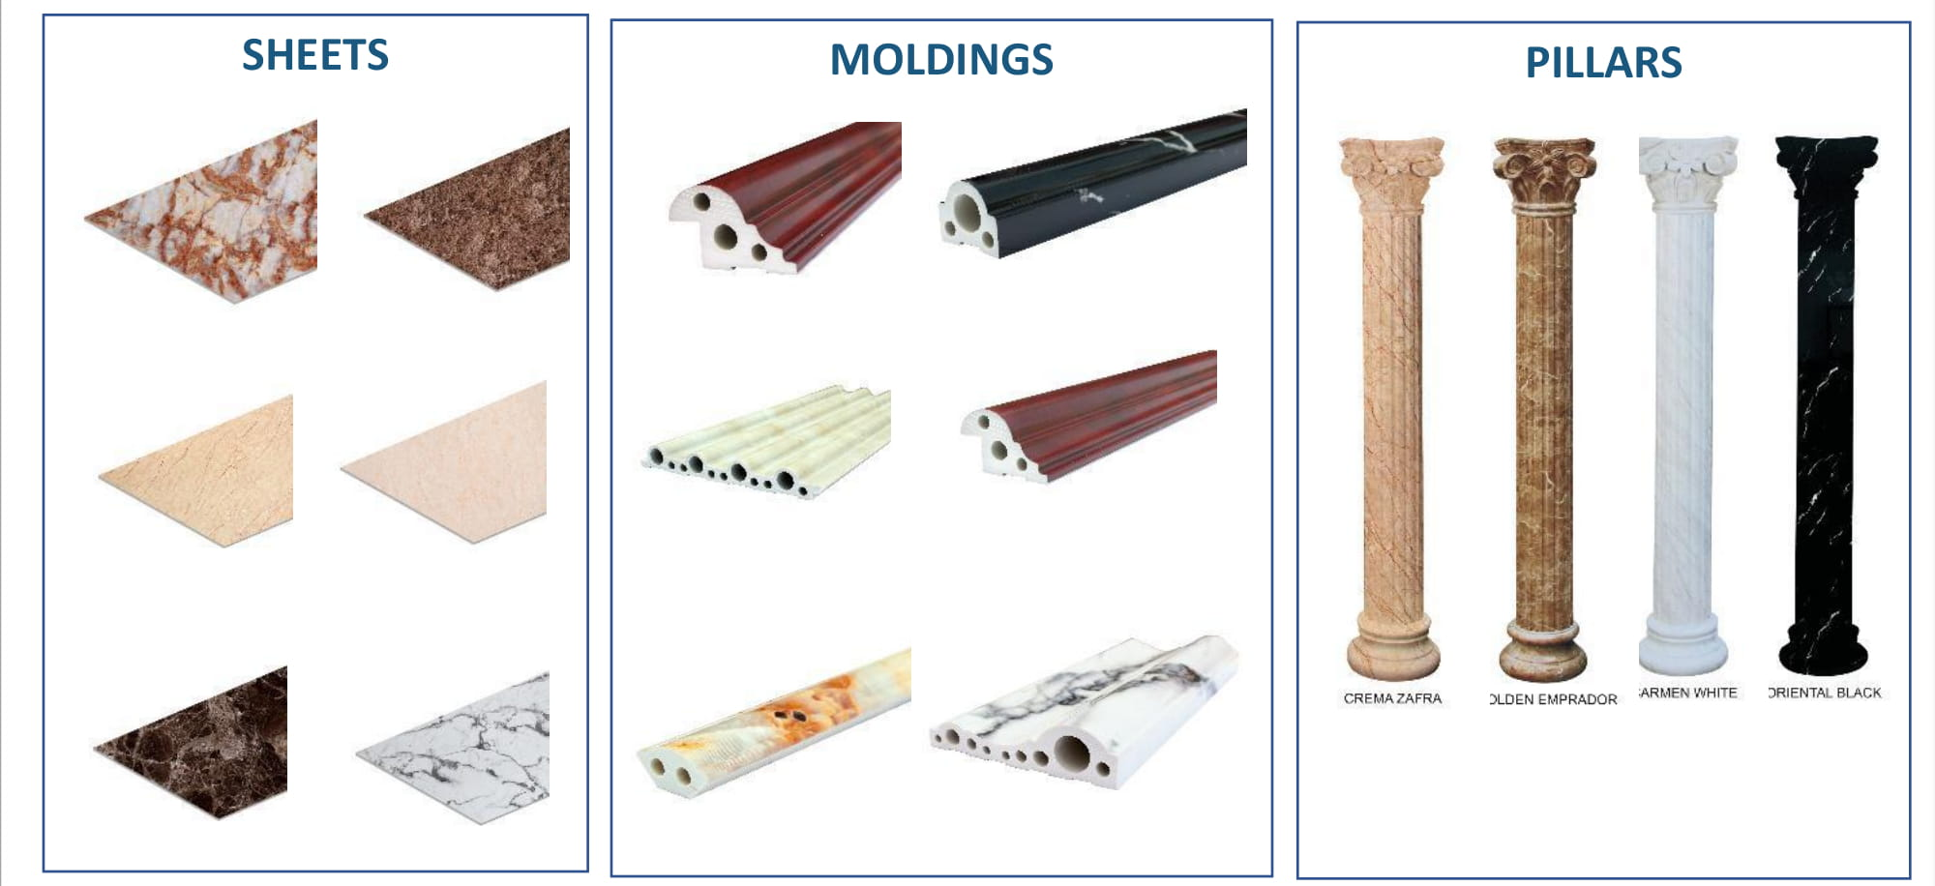
PRODUCT CATEGORIES:
Plastone is available in beautiful and lustrous sheets, moldings and pillars to provide numerous design options to bring your every imagination,
In enhancement of beauty of your interiors, to life

Slide 4
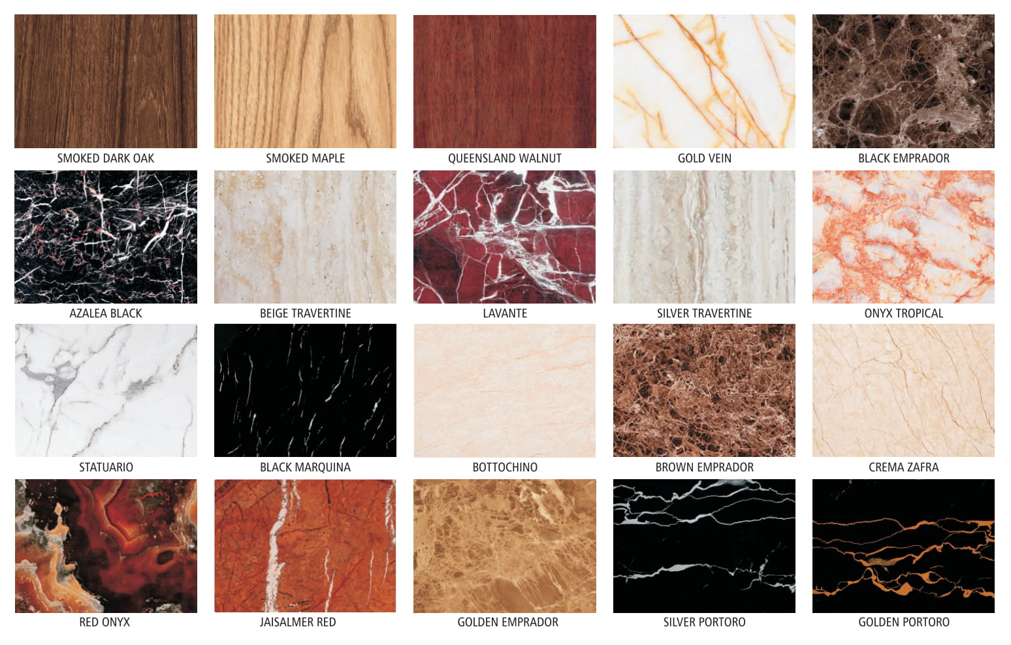
WIDE RANGE OF EXQUISITE
SHADES & TEXTURES

Slide 5
DURABLE & STABLE QUALITY
Such type of material is available in the market in many variants and qualities ranging from high to low cost. We provide the optimum quality required for perfect applications at a perfectly reasonable price, giving our customers an overall pleasant experience.
We provide the widest range of mouldings and textures. Ten different varieties of mouldings and all available in ten different textures.
The top surface of our sheets is made by coextruding a special material layer (better than the base material), and over that we put the required texture. This not only gives out a better colour quality, but also a more consistent and smooth surface finish.
Colour texture quality and surface coating quality are both of optimum level of quality, giving a lasting life to the product.
Material has sufficient level of elasticity in order to keep the level of damage minimum during fabrication and transportation.

Slide 6
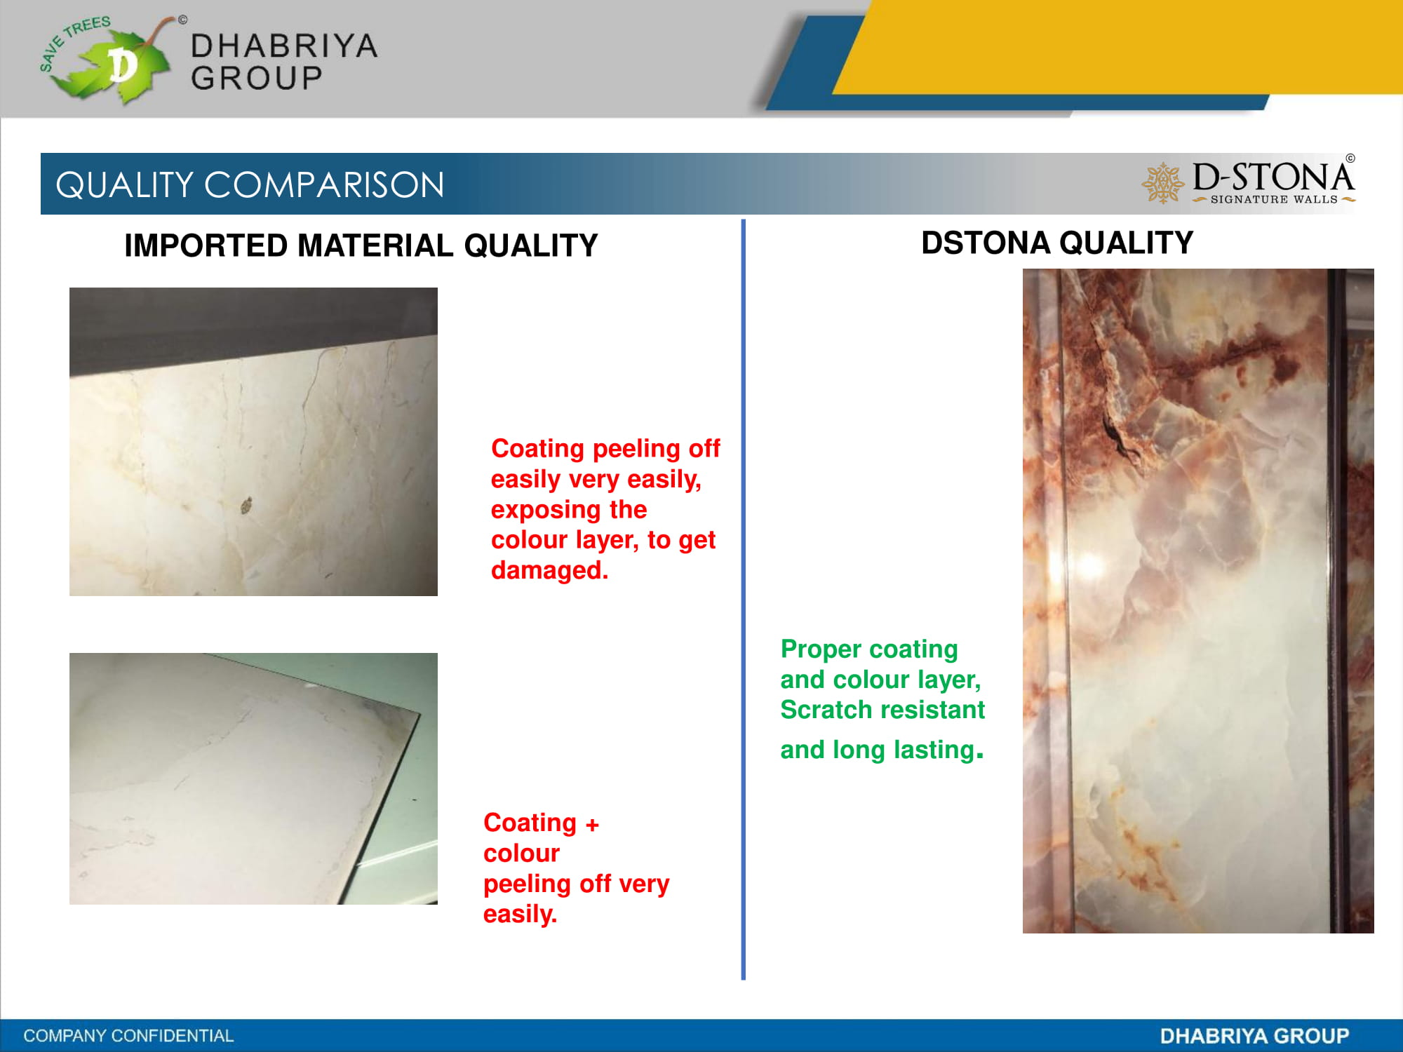
QUALITY COMPARISION
OTHER MATERIAL QUALITY PLASTONE QUALITY
Coating peeling off very easily, exposing the colour layer, easy to get damage.
Proper coating and colour layer, scratch resistant and long lasting.

Slide 7
EASY INSTALLATION PROCEDURE
Molding cutting using a miter saw.
Molding joint surface planning using a planar knife.
Molding pasting using silicone/adhesive.
Joint in moldings.
Sheet cutting using a hand cutter.
Sheet pasting using silicone/adhesive.

Slide 8
Advantages over traditional materials
Perfect finish.
Easy and speedy installation.
Uniformity in shades and textures.
Wide range of shades and textures availability.
Huge design possibilities.
Cost effectiveness.
Great variety of ready moldings availability.
Lustrous look.

Slide 9
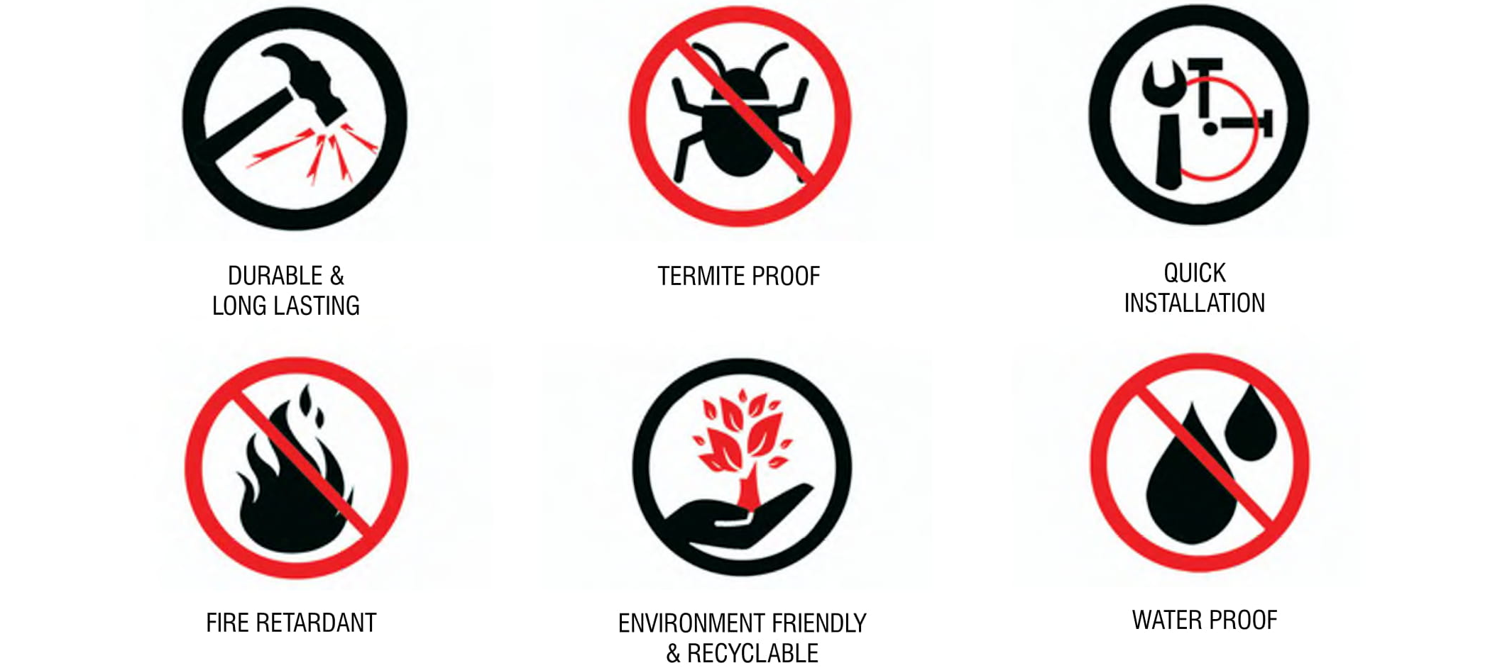

Slide 10
ALLIANZ IMPEX FZE
P.O. BOX 42215, SHARJAH, UNITED ARAB EMIRATES
TEL: +971 65391872
FAX: +971 65328168
EMAIL: allianz@eim.ae
WEB: www.allianzimpex.com

